Slide 1


Slide 2

Noida Institute of Engineering and Technology, Greater Noida
Introduction
Unit: 2
Subject: DESIGN THINKING I
Pushkal K Shukla
Department of Computer Science and Engineering
B Tech 2nd Sem

Slide 3



Course Objective
The objective of this course is to familiarize students with design thinking process as a tool for breakthrough innovation. It aims to equip students with design thinking skills and ignite the minds to create innovative ideas, develop solutions for real-time problems

Slide 4
Content
Understand stakeholders
Techniques to empathize
Identify key user problems
Empathy tools- Interviews, empathy maps, emotional mapping, immersion and observations
Customer journey maps
Brainstorming
Classifying insights after Observations, Classifying Stakeholders
Do’s & Don’ts for Brainstorming
Individual activity- ‘Moccasin walk’

Slide 5
Course Outcome
After completion of this course, students will be able to-
Develop a strong understanding of the design process and apply it in a variety of business settings
Analyze self, culture, teamwork to work in a multidisciplinary environment and exhibit empathetic behavior
Formulate specific problem statements of real time issues and generate innovative ideas using design tools
Apply critical thinking skills in order to arrive at the root cause from a set of likely causes
Demonstrate an enhanced ability to apply design thinking skills for evaluation of claims and arguments

Slide 6
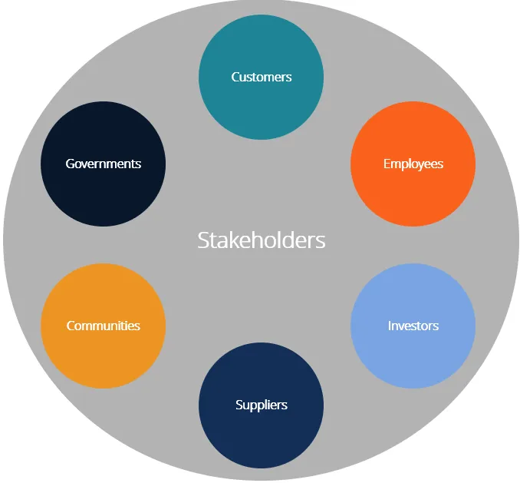
Understanding Stakeholders
Stakeholder is any individual, group, or party that has an interest in an organization and the outcomes of its actions.

Slide 7
Understanding Stakeholders
Stakeholders can be internal or external to an organization.
Internal stakeholders are people whose interest in a company comes through a direct relationship such as employment, ownership, or investment.
External stakeholders are those who do not directly work with a company but are affected somehow by the actions and outcomes of the business.

Slide 8
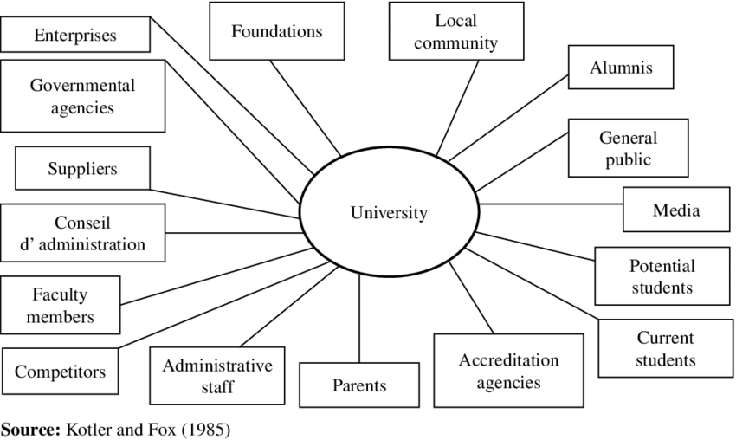
Multiple Stakeholders in Higher education

Slide 9
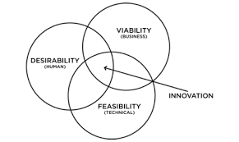
Design Thinking

Slide 10
Design Thinking
Stated and Unstated need
Observe pattern
Connecting dots
Unearthing the blind spot

Slide 11






STEP 1: EMPATHIZE/ FEEL
Feel from the customer’s shoes
Cartographer Detective Reporter
Tools
Empathy (L-D-O), Stakeholder Mapping, Persona

Slide 12
Starts with the desirability (Need) of the customer
Bring ‘clarity’ to desirability
Think like a Cartographer to create the L0 framework
Become a Detective to solve the actual problem and not symptoms
Use Persona to record the real experience of stakeholders
Take cognizance of the Design Mind elements
Ask questions “What”, “Who” and “Where”
Do not bring in the 2Js: Judgment & Justification

Slide 13
STEP 2: DEFINE
Asking the Right Questions
Paraphrase the problem statement/ opportunity
Reporter
Tools
5-Whys

Slide 14
Converge on the real problem from the data from the Feel stage
Apply the ‘5-Why’ tools to get into the root of the problem
Redefine the problem
Define the problem statement in not more than 5-7 words
Paraphrase in positive words

Slide 15
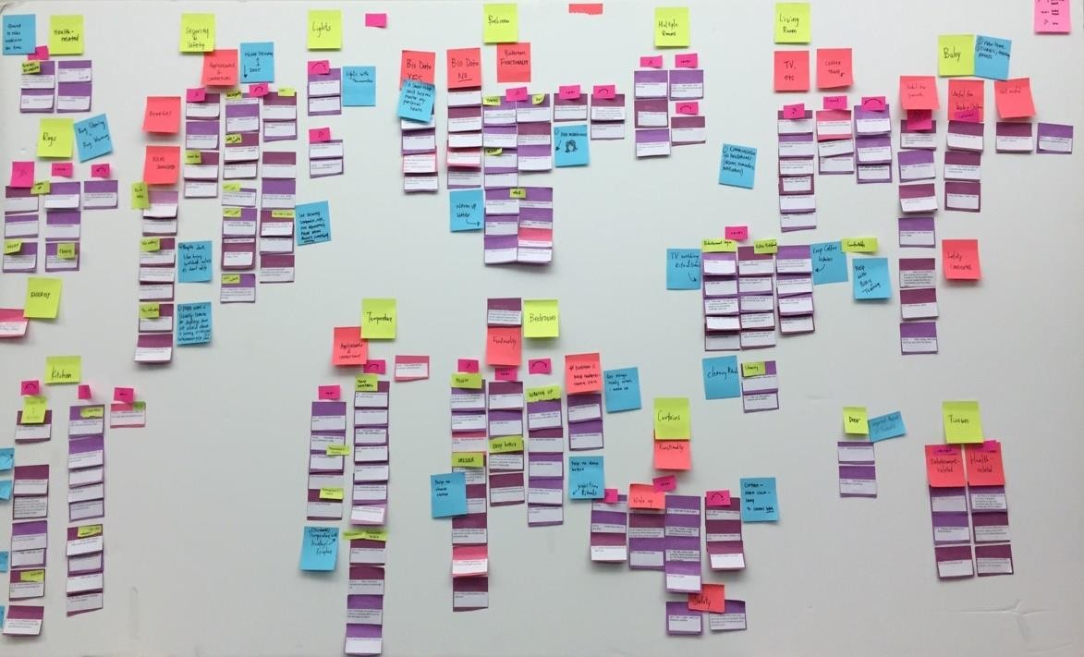
STEP 3: IDEATE/ DIVERGENCE
Collect best practices and accidents (within and outside)
Generate ideas
Create possibilities
Tools
Brainstorm

Slide 16
Divergence is bringing multiple expertise and perspective to generate ideas
Divide into multiple groups to generate ideas
Avoid being judgmental - No idea is a bad idea
Challenge all existing assumptions and biases; policies / processes of organization
Round 1: Positive patterns within and outside the organization
Round 2: Anti-patterns (what fails in real life)

Slide 17

Create affinity clusters from ideas
Connect the ideas
Classify ideas into Quick, Bold
and Long Lasting impact
Make choices (Delete 80%)
Prototype / Test design
Tools
10-100-1000 gm, Q-B-L

Slide 18
STEP 4: PROTOTYPE/ CONVERGENCE
Create affinity group of all ideas generated during Divergence
Now the ideas are of the group and not of individuals
Connect similar ideas and multi-vote using 10-100-1000gm
Apply Q-B-L on 1000gm ideas
Connecting multiple ideas moves from idea to solution
Selected solution can be prototyped
Iterate to Steps 2 and 3 if the solution does not give a 'wow' feeling

Slide 19

STEP 5: TEST/ COMMUNICATION
Naming
Packaging
Story boarding
Presentation
Distribution

Slide 20
Is key to scale up a solution or institutionalizing the innovation or process
Use key words which define the proposed solution
Use new vocabulary to get attention - use 'Shift Left' instead of 'proactive planning'
Become a movie director
Distribute the communication through white papers, advertising, social media etc. to get desired results

Slide 21
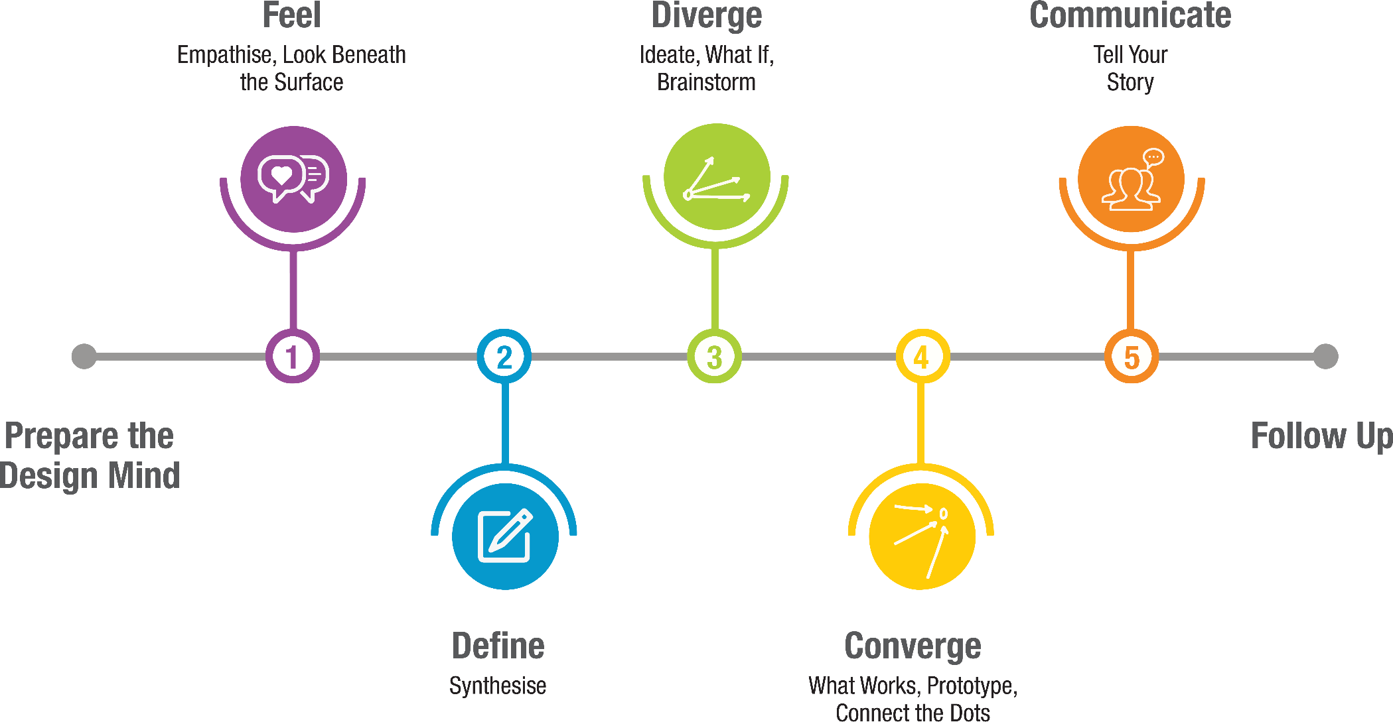
5 STEP DESIGN THINKING PROCESS©
Copyright Arun Jain,PBHL, 2021

Slide 22
Empathise methods: The following are our favourites Empathise methods:
Assume a beginner’s mindset
Ask What-How-Why
Ask the 5 whys
Conduct interviews with empathy
Build empathy with analogies
Use photo and video user-based studies
Use personal photo and video journals
Engage with extreme users
Story share-and-capture
Body storm
Create journey maps

Slide 23



LISTENING
DIALOGUE
OBSERVATION

Slide 24
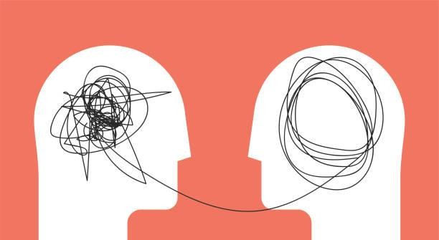
EMPATHY MAP

Slide 25
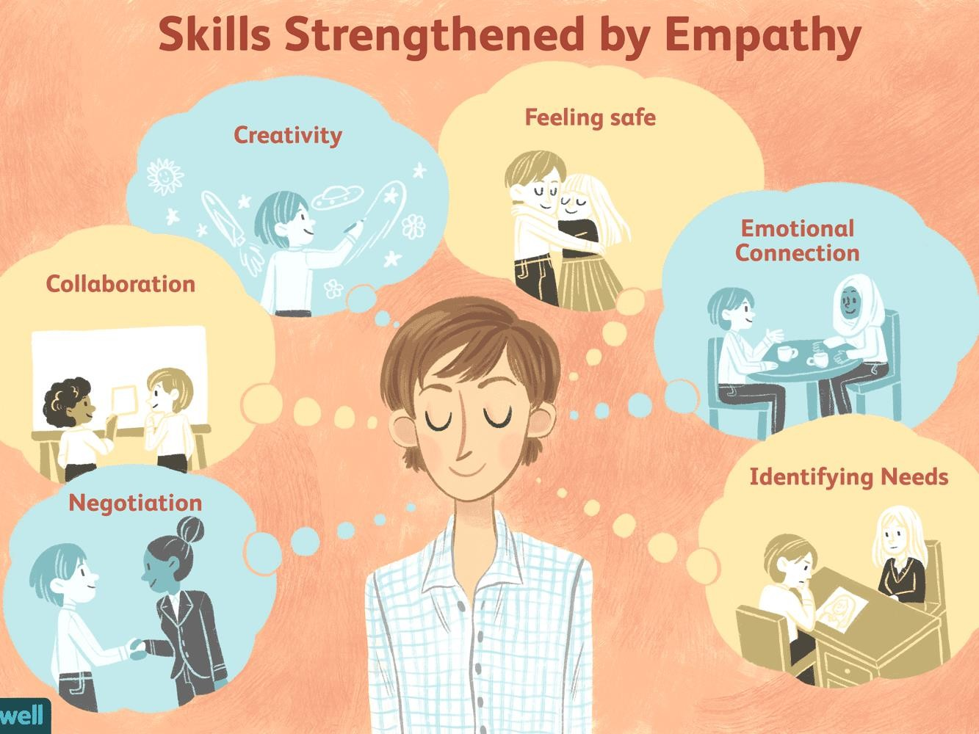

Slide 26
WHAT IS EMPATHY MAP?
A simple, easy-to-digest visual that captures knowledge about a user’s behaviors and attitudes.
Helps designers see things from the user’s perspective.
Could a greater miracle take place than for us to look through each other’s eyes for an instant?
Henry David Thoreau
American naturalist, essayist, poet & philosopher

Slide 27
WHEN SHOULD IT BE USED?
An active ingredient during Listening, Dialogue, Observation
Used right from the outset of the Design Thinking Process to help the Design Thinker develop empathy, understanding, experiences, insights and observations.
But...
It is an iterative tool. Users can go back to the map and refine it as and when they notice something new during a dialogue or interaction with the user.

Slide 28
HOW TO USE THE TOOL
Examine a user’s experience and imagine what it is like to be him/ her.
Complete the sections of the map to capture what the user sees, does and hears.
No set order for completing each section, but it may be easier to start with the
observable activities in the user’s world.

Slide 29




FEELS
THINKS
SAYS
DOES
INSIGHT
INSIGHT
POSITIVE insights after capturing the above data
NEGATIVE insights after capturing the above data

Slide 30
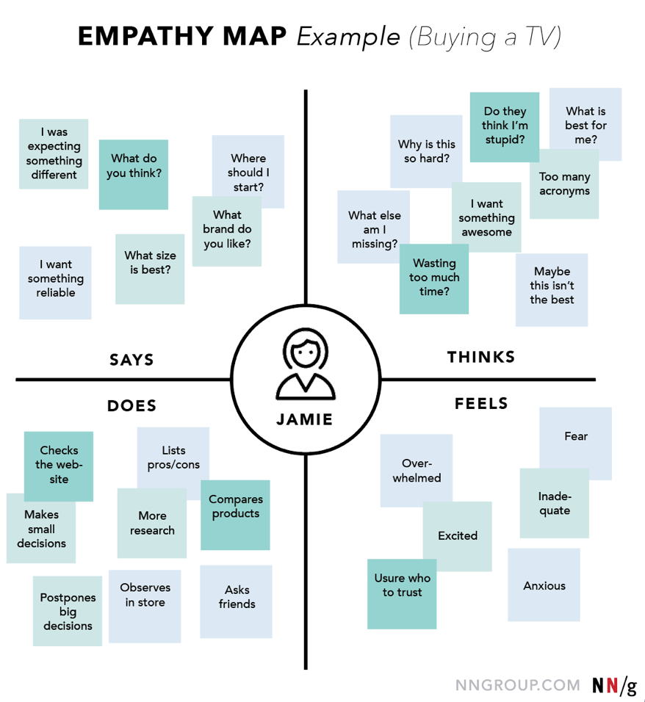

Slide 31
Primary & Secondary Market Research
Secondary market research provides basic information on which primary research needs to be done.
Secondary Sources of Information
Primary Sources of Information
Information from publications
Sources from the Internet
Data by the government
Reports by research institutions
News reports
Academic journals
Newsletters
Interviews
Surveys
Fieldtrips
Focus groups
Listen… Dialogue… Observe!

Slide 32
How to Interview?
Surveys & questionnaires
Online / post / in-person
Focus groups - in person / video conference
One-to-One - face-to-face / telephone
Qualities of an Interviewer
Good listener
Open minded
Observant
Curious
Empathetic

Slide 33





CLASSIFICATION OF OBSERVATION
Cognitive
Physical
Emotional
Social
Cultural

Slide 34
STAKEHOLDER MANAGEMENT

Slide 35
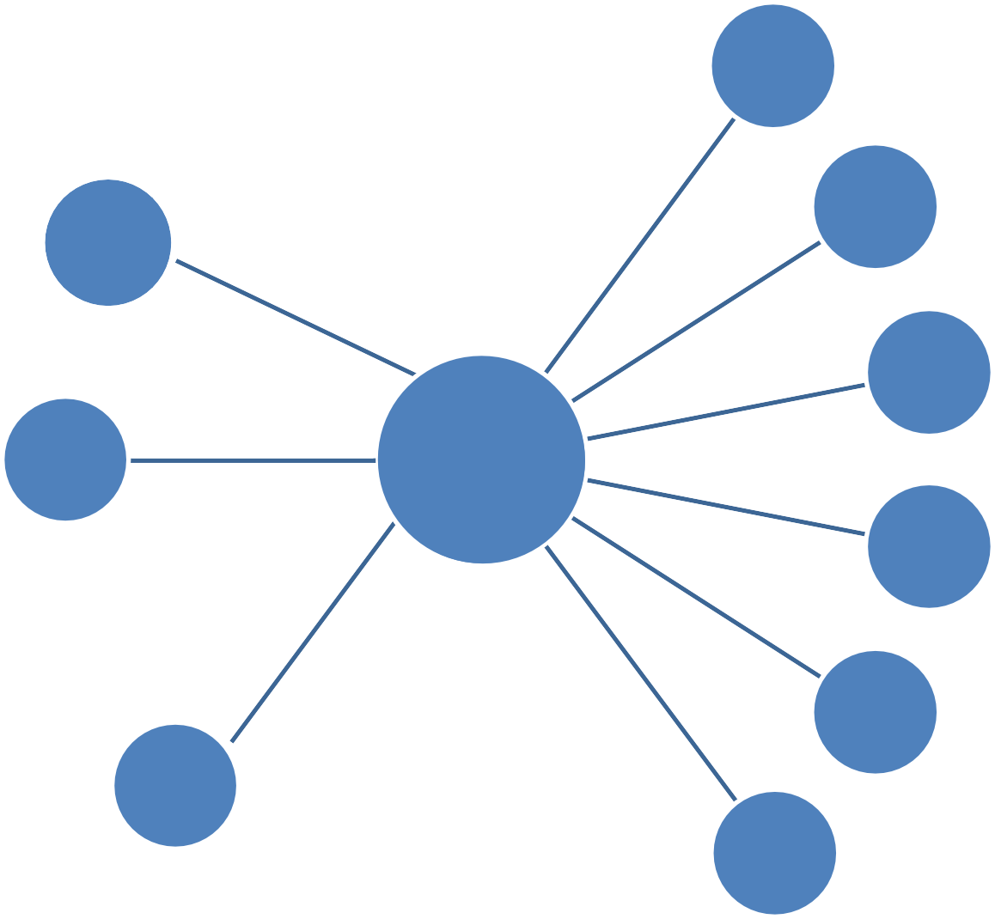
Stakeholder Mapping
Ministry of Finance
Ministry of IT
Ministry of Labor
Ministry of Home
Ministry of Railways
etc.
Central Government
Ministry of Home
Ministry of IT
Ministry of Labor
Ministry of Finance
Airport Security Check-In
Railway Ticket Collector
State Government
Non- Mandatory Identification
Income Tax Dept
Election Commission
Land & Revenue Departments
Passport Offices
Etc.
Govt. Bodies
Cylinder & Subsidy Transfers / Direct Account Transfers
Affordable Ration Distributors
  Provident Fund Service
Public Services
AADHAR
CITIZENS OF INDIA
NRIs
OICs
Migrants working in
India
Public
Software Vendors
Application
Consultants & Partners
Training Partners
Network Providers
Ministry of Information &
Broadcasting
  Public Broadcasters
  Private Broadcasters
Media
Indian Judiciary
Parliament of India
Legal

Slide 36

CATWOE ANALYSIS
FOR BETTER STAKEHOLDER MANAGEMENT

Slide 37

Genesis
David Smyth, 1975
He was working for Soft Systems Methodology (SSM), an approach for solving organizational problems
CATWOE Analysis technique was considered as one of the important part of SSM approach while identifying stakeholders in solving problems

Slide 38

How it Helps
Enlists all the stakeholders who would be affected while solving problems & understand their perspective
Helps to avoid the personal bias/beliefs of problem solvers as they critically discuss each element of CATWOE
Unearths the bigger picture with regards to constraints, challenges, possible outcomes and their effects on the stakeholder(s)
Understand the conflicts between stakeholders, their roles, conflicts in roles & possible actions (they might take) during the process of problem solving

Slide 39

Where is CATWOE used?
To solve any complex problem where multiple stakeholders are involved
To change an existing system impacting a variety
of people
To enable Change Management for better adoption of change by stakeholders
Used in typical Project Management
To launch a concept that will radically change the existing system

Slide 40

Elements of CATWOE
The ‘CAT’
Customers
Those who face the current problem for whom you will be working on the solution Those who will be using your solution
Those directly affected by your idea
Actors
Those who actually implement the solution/transformation
Transformation
Does not involve writing any stakeholder; but write in clear-cut terms about the Why, What, How
of the problem and the solution/transformation you wish to bring to solve
By clearly thinking and writing, you will think of stakeholders who can be classified in other elements

Slide 41
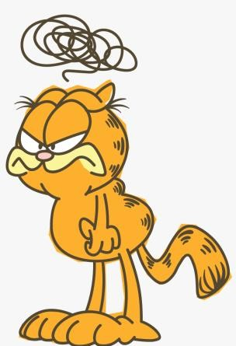
Elements of CATWOE
The ‘WOE’
Worldview
Very important during analysis when thinking beyond the system
Considering stakeholders beyond current system who will be affected indirectly by solution/transformation
Think of the bigger picture (beyond the system)
Owners
Stakeholders who own the permission to start/stop/pause/cancel your transformation / solution
Leaders who have the ability to guide the solution as well as block it
Environment Constraints
Constraints (legal, political, ethical, regulation, norms, financial, human power, etc.) or rules that may hinder solution implementation

Slide 42
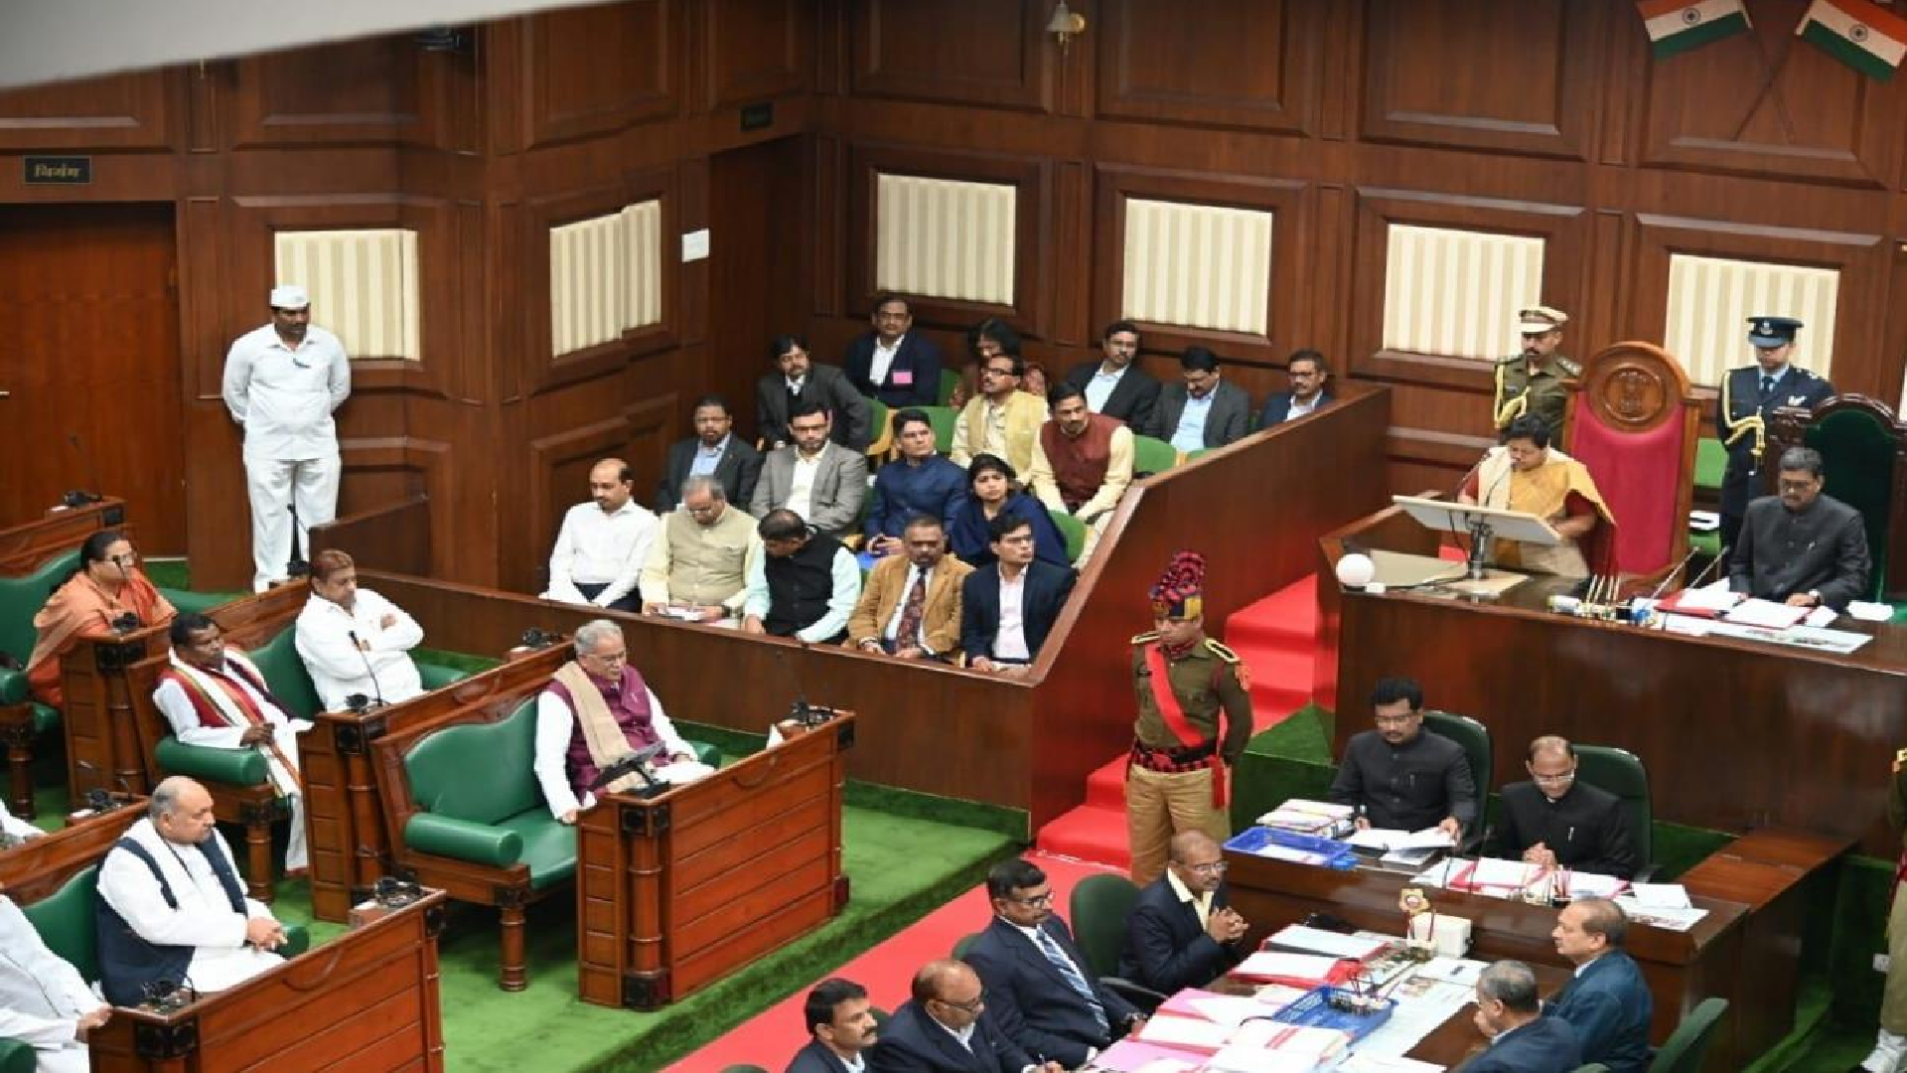
An Example
Imagine that you are a Labour Minister of a state government in India & you are planning to introduce a bill in the state assembly. The proposed bill is about ensuring 85% of jobs for local/domiciled residents of the state for any government, private companies & NGOs that is operating business out of your state. The bill also mandates that if the hired locals don’t have needed skills for the job, it is the responsibility of the business to train them in skills after hiring.
Who are the stakeholders according the CATWOE?

Slide 43
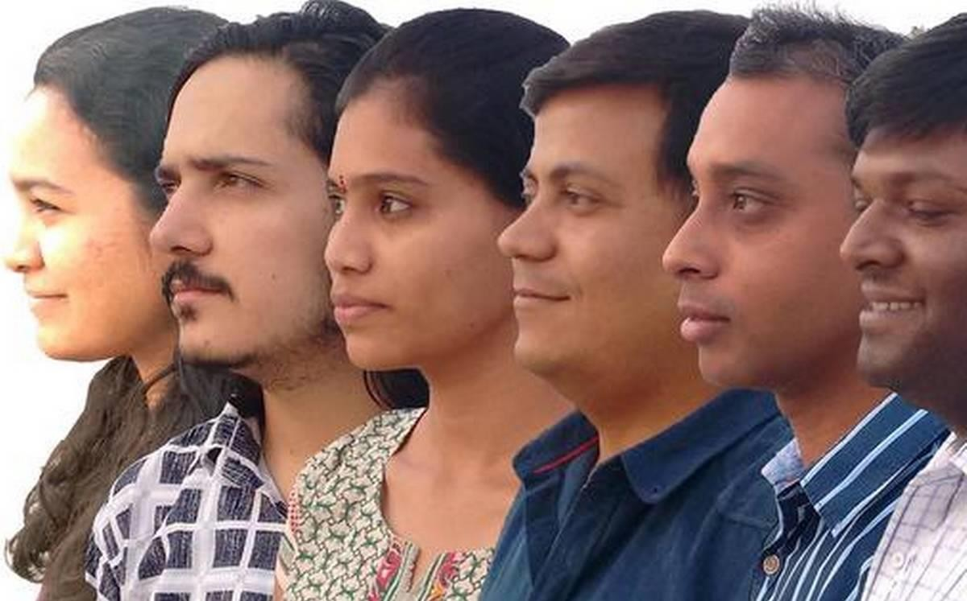
Stakeholder 1: Customers
Residents of that state who will now have many job opportunities
Residents of other states of India and international migrants who will now have fewer job opportunities
Government, Private organizations and NGOs that will be directly affected by this bill
And many others!

Slide 44

Stakeholder 2: Actors
Human Resources teams who now will have to revise their future hiring plans
Project Managers who have non-local team members in majority will have to reshuffle
(Their team-composition will be affected)
Labor department officials who may inspect in random workplaces to check for
compliance
And many others!

Slide 45
Stakeholder 3: Transformation
The government feels that injustice is being done to natives by various organizations that run
their business in the state offering employment opportunities to migrants outside the state.
Natives have to leave the state in search of job opportunities when there is potential to earn
in their state. This is a serious ‘talent drain’ for the state.
To retain local talent and to benefit the organizations the government proposes 85% of jobs for local/domicile residents of the state for any government, private companies & NGOs that are operating in the state.
The bill also mandates that if the hired locals don’t have required skills for the job, it is the responsibility of the business to train them after hiring.

Slide 46

Stakeholder 4: Worldview
Customers of the government, private companies & NGOs will be affected due to changes in employee strength, teams etc. This will impact delivery of services, quality of services, etc.
Investors/shareholders, promoters, creditors of organizations
New business opportunities for training organizations within the
state to train locals who need skills
Placement in colleges will be affected positively or negatively depending upon students’ background
Students seeking internships/placements
Leaders of other states will have to decide on inflow of migrants back to their state
And more!

Slide 47
Stakeholder 5: Owners
Ruling party MLAs, Opposition party, Ruling alliance,
Opposition alliance, Independents
Their votes will matter to pass bill in assembly
Party high command of ruling party
The opinion of high-command will matter
Assembly Speaker Governor of the state
Only after his approval the bill becomes a law
Regional & National Media
Coverage of the issue will play a major role in conveying message to the audience
Central Government
May see this bill as a source of employment crisis in the
state

Slide 48

Stakeholder 6: Environment Constraints
Poor execution of the law thanks to bribery by organizations to Labor Department officials during inspection (to retain the migrant workforce)
Vested interested groups finding loopholes in law thus failing execution
Possible legal challenges such as Public Interest Litigations by citizen groups leading to probable court intervention
Corruption in government organizations leading to production of fake domicile documents (residence proof)
And more!

Slide 49
Exercise
Imagine that you (CEO) want to launch a new travel booking application in the market.
Who are the stakeholders according the CATWOE?

Slide 50
Stakeholder 1: Customers
Passengers who want to travel (Seniors, Students, Millenials, Married Couples, Working,
Corporate etc)
Travel agents who book tickets
Indian Railways, State & Private Bus Providers , Airlines
Hotels & Resorts
Banks & Payment Gateways
And many others!

Slide 51
Stakeholder 2: Actors
Your organization
Marketing Team
Sales Team
Customer Service Team
HR Team
Design Team
Partners

Slide 52
Stakeholder 3: Transformation
I feel that existing apps are looting the people. They don’t have tie-ups with good hotels, resorts & are not providing good lucrative deals/offers for the customers. Instead, they are charging very high commission prices. Additionally, the look & feel of the application is very poor & not everyone is comfortable in using it.
So, I would want to launch an app in market that will provide several good options for the customers by forming tie-ups with many quality airlines, bus-service providers, resorts etc. Also, I wont charge too hig commission prices for the customers but instead provide good look & feel for the app. That will automatically help more people to use the app.
The popularity of the app will be so compelling that banks will provide attractive deals/offers
for the customers.
In the end; I just want to make Ticket Booking a very pleasant & smooth experience.

Slide 53
Stakeholder 4: Worldview
Travel Agents
Small investors
Folks who check tickets (Train Ticket Collectors, Gate Security Staff @ Airports, Check-in attendants @ hotels/resorts)

Slide 54
Stakeholder 5: Owners
Venture Capitalists
Angel-Investors
Mentors
Board Members
SEBI & similar organizations
Auditors
Playstore, iOS etc

Slide 55
Stakeholder 6: Environment Constraints
Competitors / Lobby
Technical Constraints – E.g:- Removal of app from Play store because of poor ratings
Employee Unions - E.g:- Poor treatment allegations from workforce
Investment Related Constraints – E.g:- Changes in policy that will affect investments

Slide 56
Journey Mapping
A Journey map is a representation of personal experience in a graphic format.
These maps can depict your past, present or future state of the journey.
As you map the journey you can identify the emotional ups and downs.

Slide 57
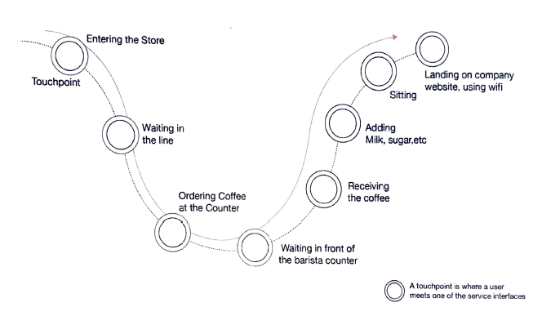
The Barista Coffee Shop Experience Journey Map

Slide 58
Personas in Design Thinking
Persona is a archetypical users that helps designers and developers empathize by understanding their user’s business and personal context.
A persona is represented in 1-2 page documents.
Designers creates a persona template.

Slide 59
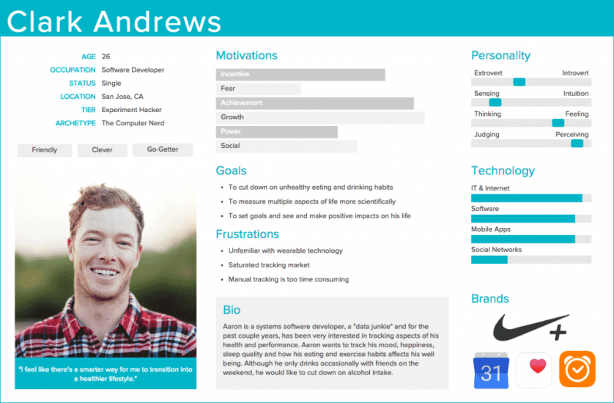
Personas in Design Thinking

Slide 60
Characteristics of a good persona
Personas aren’t fictional guesses at what a target user thinks.
Personas reflect real user patterns.
A persona focuses on the current state .
A persona is context-specific .

Slide 61
5 Steps to creating user personas
Collect the information about your users
Identify behavioral patterns from research data
Create personas and prioritize them
Find scenario(s) of interaction and create user personas UX documentation
Share your findings and obtain acceptance from the team

Slide 62
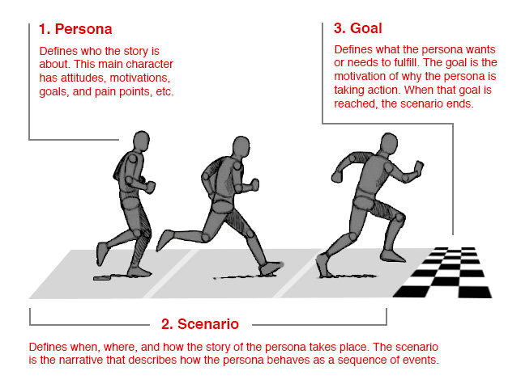

Slide 63
Thank You!

